Slide 1

DIGITAL ELECTRONIC MINI PROJECT PRESENTATION
Four Way Traffic Light system
PRESENT BY GROUP:-M

Slide 2
Group:-M Four Way Traffic Light system
SUBJECT :-DIGITAL ELECTRONIC(BEEC2404)
LECTURER:NIZA MOHD IDRIS
RAHMAN KAZI ASHIKUR (B081910450)
MOHAMAD A’ARFAN BIN AZHAR (B081910059)

Slide 3
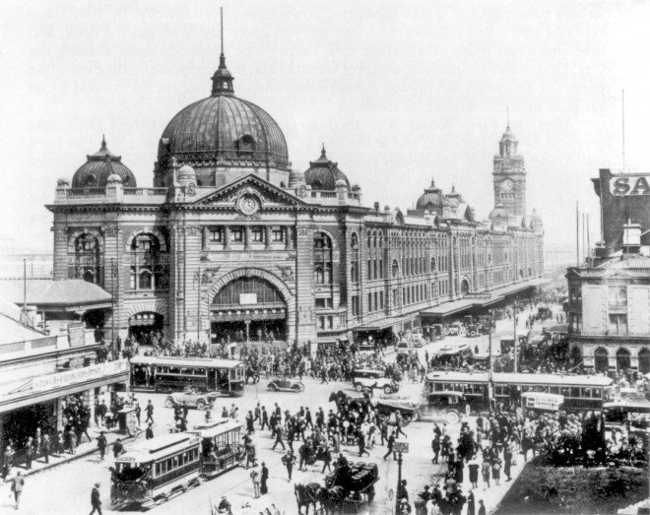
on 5 August 1914, the American Traffic Signal Company installed a traffic signal system
Group:-M Four Way Traffic Light system
Figure.1:-Picture of Before traffic light system create

Slide 4
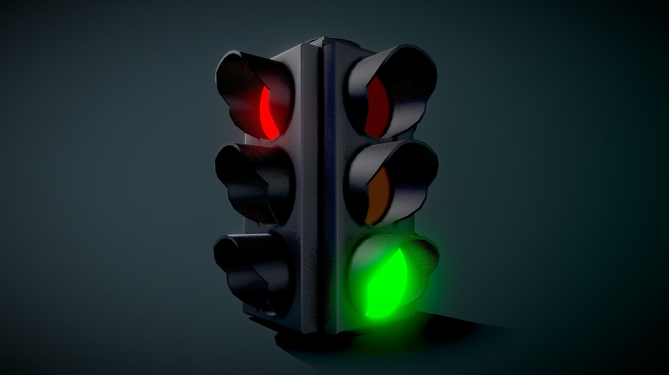
Four Way Traffic Light system Using D Flip Flop
Group:-M Four Way Traffic Light system
Due to the increase in traffic, the user of vehicles is facing too many problems on roads. Sometimes the roads get block

Slide 5
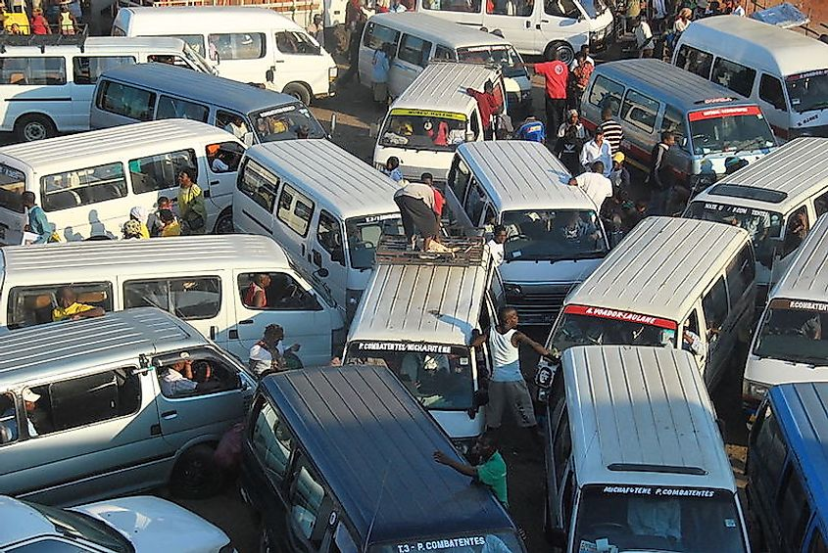
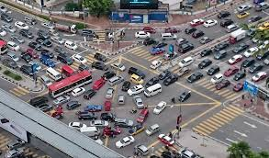
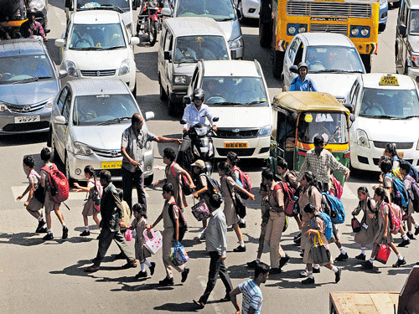
Group:-M Four Way Traffic Light system
PROBLEM STATEMENT
To control the consistency
of the cycle of the traffic.
To avoid collision vehicles with public
TO AVOID THE COLLISION OF VEHICLES

Slide 6
For this project we will discuss about.
Group:-M Four Way Traffic Light system
Animation Video Of This Project
Block diagram of this project
Truth Table
Karnaugh Mapping (for Boolean expression )
Circuit design
PCP design

Slide 7
COMPONENTS OF THIS PROJECT.
Group:-M Four Way Traffic Light system
D type flip flop (IC7474)
7 AND GATE(IC7408)
3 OR GATE(IC7432)
1 NOT GATE(IC7404)
BATTERY 9V
4 L.E.D traffic light
1 DIGITAL CLOCK GENERATOR
WIRE

Slide 8
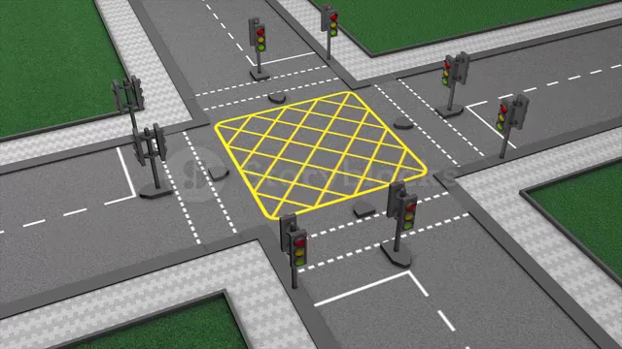
ANIMATION VIDEO OF THIS PROJECT
Group:-M Four Way Traffic Light system

Slide 9
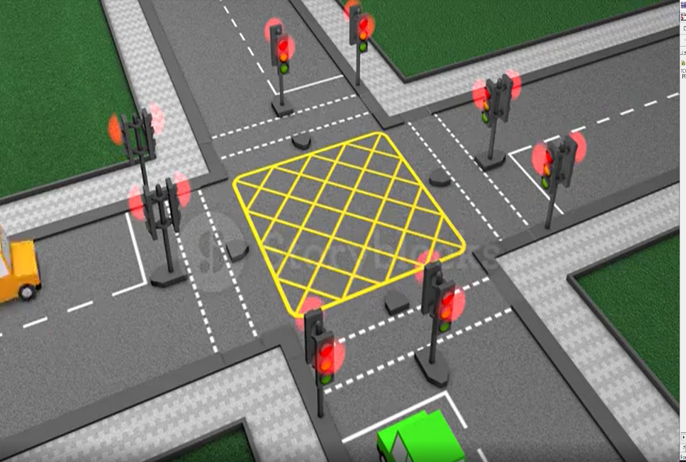
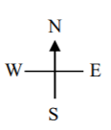


Group:-M Four Way Traffic Light system
1
NS=R
EW=G
2
NS=RE
EW=Y
6
NS=R
EW=R
3
NS=R EW=R
R1
A1
G1
5
NS=Y
EW=R
4
NS=G
EW=R
R2
A2
G2
Diagram of this project

Slide 10
Group:-M Four Way Traffic Light system
N-S | E-W
RED | GREEN
RED | AMBER
RED | RED
GREEN | RED
AMBER | RED
RED | RED
RED | GREEN
State NO | R1 | A1 | G1 | R2 | A2 | G2
1 | 1 | 0 | 0 | 0 | 0 | 1
2 | 1 | 0 | 0 | 0 | 1 | 0
3 | 1 | 0 | 0 | 1 | 0 | 0
4 | 0 | 0 | 1 | 1 | 0 | 0
5 | 0 | 1 | 0 | 1 | 0 | 0
6 | 1 | 0 | 0 | 1 | 0 | 0

Slide 11
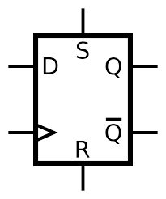
Select the type and number of flip-flops for the circuit
Group:-M Four Way Traffic Light system
Since the number of states is equal to six, the minimum number of flip-flops, which can support six states.
The maximum number of flip-flops we have to use six (one flip-flop per state).
In our this design we will use three D-type flip-flops. There will be two unused states.
D1
D2
D3
Figured : D(data)FF

Slide 12
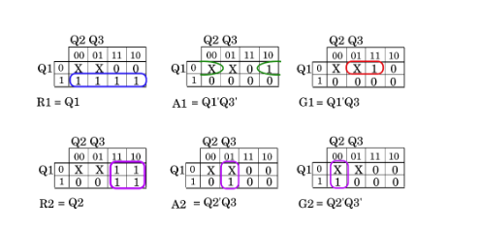
We could, for example, make R1=Q1 and R2=Q2he third output, Q3 must be assigned such that all used states are distinct. One possible set of assignments are shown below:
State | Q1 | Q2 | Q3 | R1 | A2 | G1 | R2 | A2 | G2
1 | 1 | 0 | 0 | 1 | 0 | 0 | 0 | 0 | 1
2 | 1 | 0 | 1 | 1 | 0 | 0 | 0 | 1 | 0
3 | 1 | 1 | 1 | 1 | 0 | 0 | 1 | 0 | 0
4 | 0 | 1 | 1 | 0 | 0 | 1 | 1 | 0 | 0
5 | 0 | 1 | 0 | 0 | 1 | 0 | 1 | 0 | 0
6 | 1 | 1 | 0 | 1 | 0 | 0 | 1 | 0 | 0
7 | 0 | 0 | 0 | X | X | X | X | X | X
8 | 0 | 0 | 1 | X | X | X | X | X | X

Slide 13
0,1
1
NS=R
EW=G
0
2
NS=RE
EW=Y
6
NS=R
EW=R
1
0
1
0
3
NS=R EW=R
5
NS=Y
EW=R
0
4
NS=G
EW=R
0,1

Slide 14
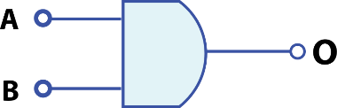
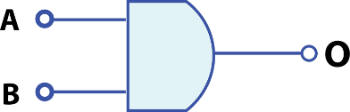


Group:-M Four Way Traffic Light system
R1
A1
D1
G1
D3
G2
R2
D2
A2

Slide 15
Title and Content Layout with Chart

Slide 16
Two Content Layout with Table
First bullet point here
Second bullet point here
Third bullet point here
Class | Group 1 | Group 2
Class 1 | 82 | 95
Class 2 | 76 | 88
Class 3 | 84 | 90

Slide 17
Title and Content Layout with SmartArt
Step 1 Title
Step 2 Title
Task description
Task description
Task description
Task description
Task description
Task description
Task description
Step 3 Title
Task description
Task description
Step 4 Title
Task description
Task description

Slide 18
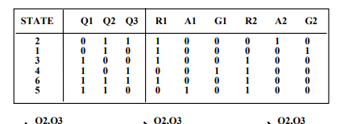
Add a Slide Title - 1

Slide 19
Add a Slide Title - 2

Slide 20
Add a Slide Title - 3

Slide 22
Add a Slide Title - 4

Slide 23
Add a Slide Title - 5

